Slide 1
Progress Update
2022-10-25
송희수

Slide 2

ImageJ - ThunderSTORM
Raw data processing/feature enhancement & sub-diffraction localization of molecules (PSF fitting – weighted non-linear least-squares methods)
Create list of molecules with position, sigma (FWHM), and intensity
https://academic.oup.com/bioinformatics/article/30/16/2389/2748167
Wiki page: https://github.com/zitmen/thunderstorm/wiki

Slide 3
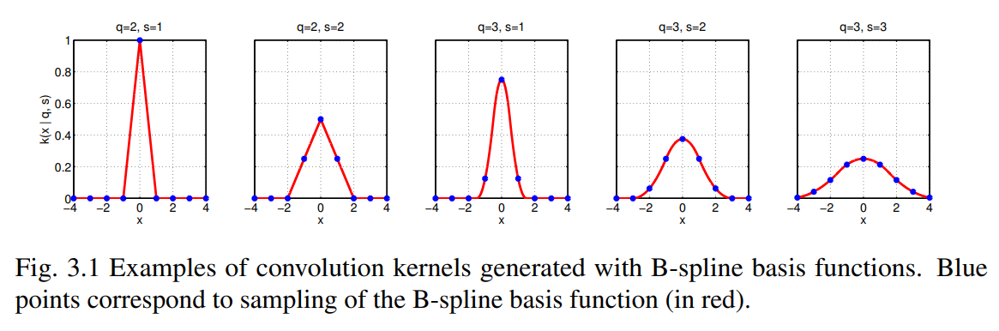
ThunderSTORM – Image processing
Convolution with Wavelet filter

Slide 4
ThunderSTORM - Parameters
이전 연구에도 ThunderSTORM을 사용한 것으로 확인됨.
이전에 쓰던 parameter history남아있음
Default parameter가 여러 연구에서 보편적으로 결과가 좋음
Default parameter와 이전 parameter 결과 비교

Slide 5
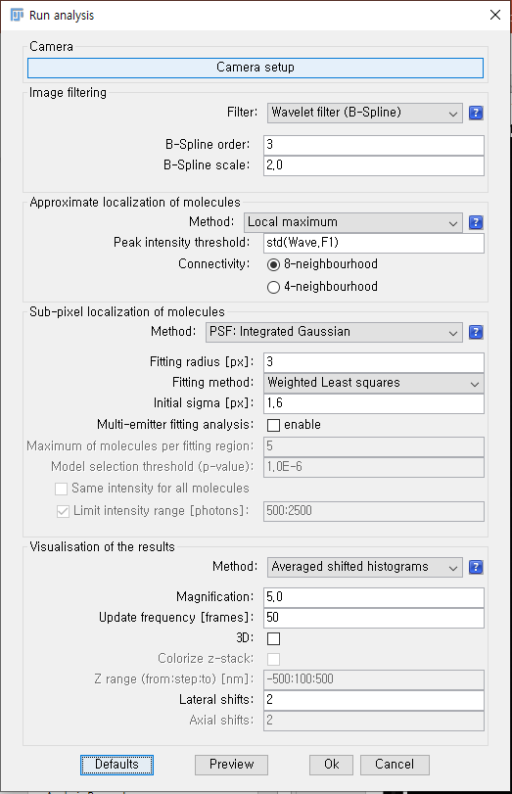
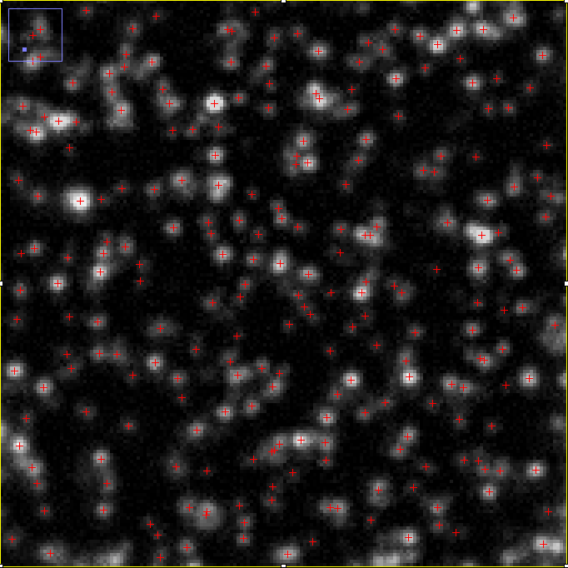
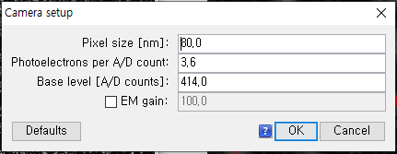
Analysis Parameters (Raw Img+ Default)
Raw image를 넣고 analysis를 돌렸을 때의 spot detection 결과.
보기 좋게 하기 위해 analysis이후 별도로 간단한 contrast control & background subtraction 했음.
S1_W6_Px1_Py1_C3

Slide 6
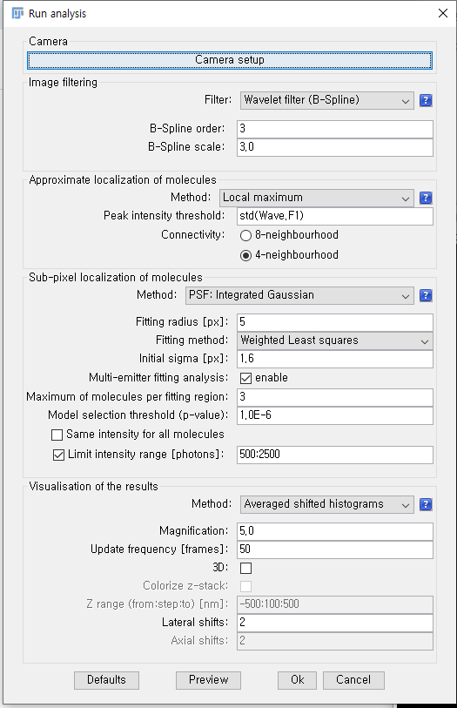
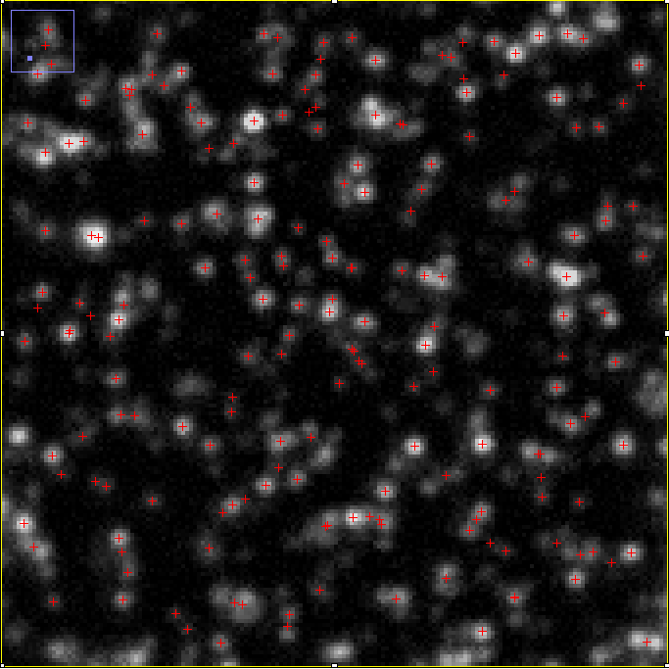
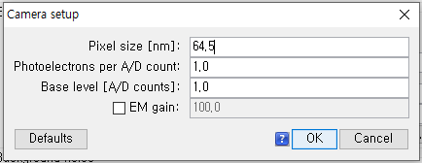
Analysis Parameters (Raw Img+ Previous)
낮은 localization 정확도
중복 detection
Default parameter에 pixel size만 도입해도 될 듯… (정확한 카메라 셋업이라는 가정하에)
Exosome localization에는 차이 없음. 단지 x, y (nm) position차이

Slide 7
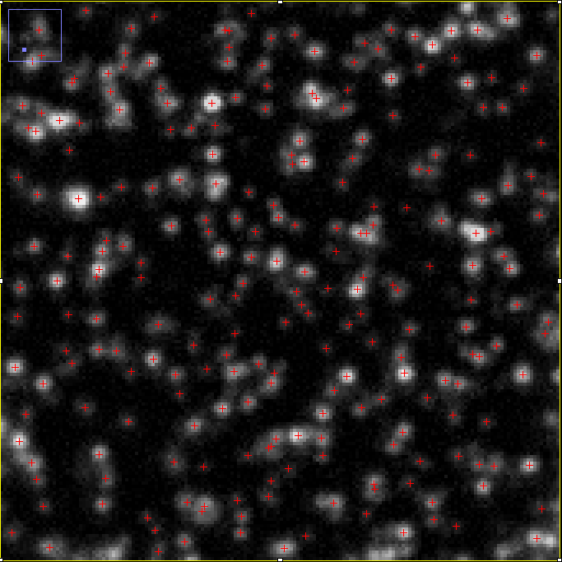
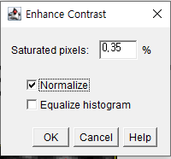
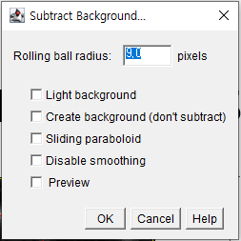
Analysis Parameters (Processed Img+ Default)
Normalization -> Background Subtraction -> ThunderSTORM analysis
거의 비슷하나, 약간의 localization 정확도 향상
Detect되지 않던 곳들(low intensity)도 detect -> 의미가 있는지는 확인필요

Slide 8
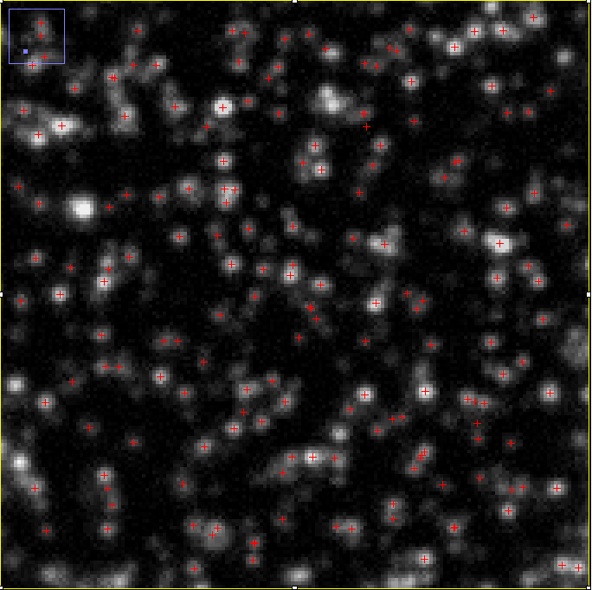
Analysis Parameters (Processed Img+ Previous)
- 변화 있음. 그런데 긍정적인 변화인지는…

Slide 9
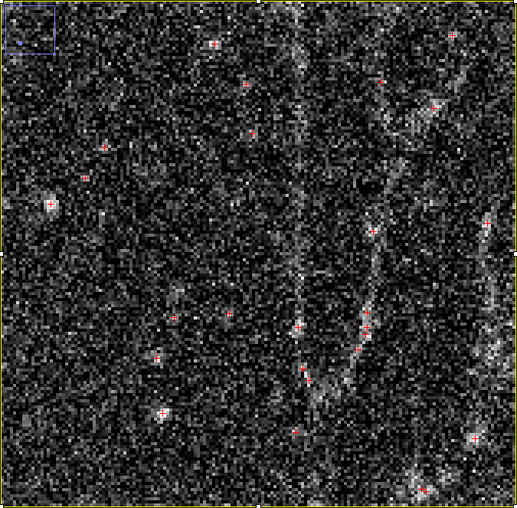
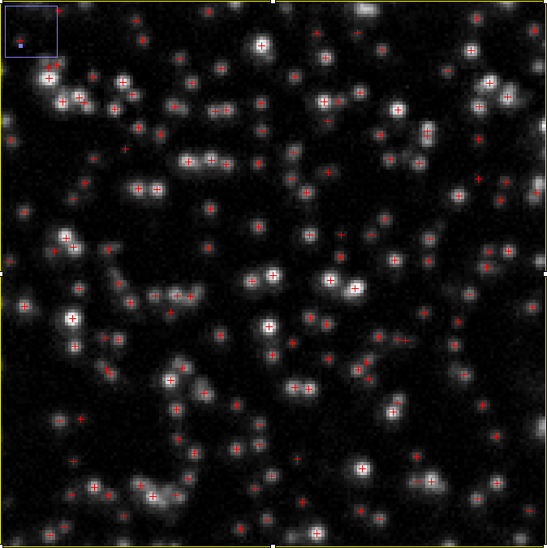
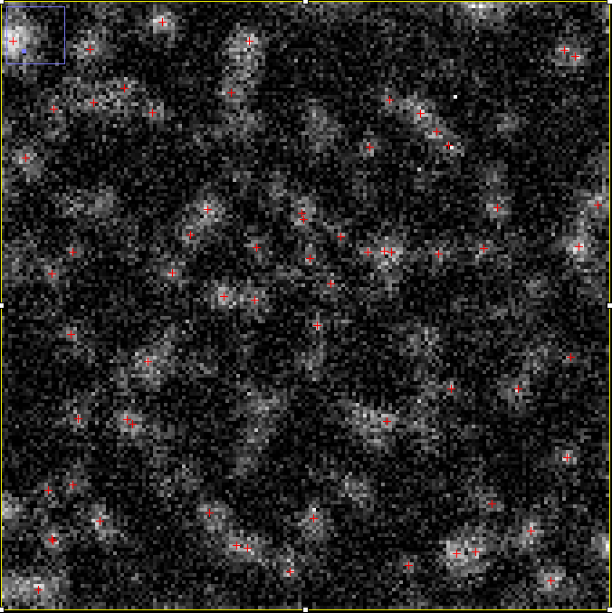
Compare Channels (Same location)
C1
C2
C3
C4
S1_W6_Px1_Py1_C3

Slide 10
C1
Noise? Or Spot?

Slide 11
C2

Slide 12
C3

Slide 13
C4

Slide 14
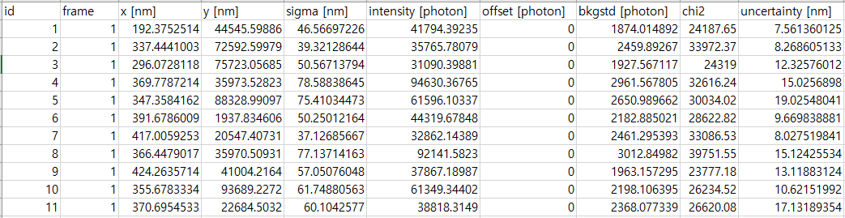
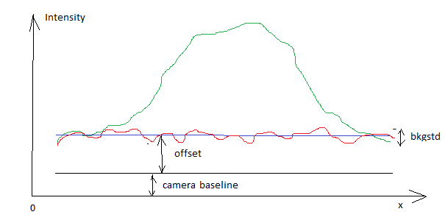
Example Result Table (C1)
1 Spot
Sigma = Std(Gaussian model used for fitting = weighted least squares)
Intensity = raw intensity. Total # of photons under fitted gaussian
Offset = Residuum after subtraction of fitted model
Bkgstd = Minimum intensity value
Chi2 = Error in raw intensities in a full fitting region
Uncertainty = Thompson formula (https://pubmed.ncbi.nlm.nih.gov/11964263/) –> Calculate std of x,y position

Slide 15
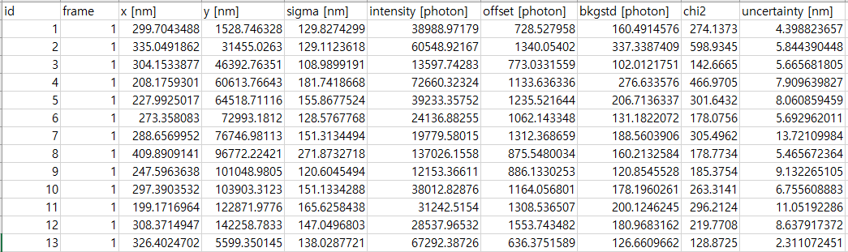
Example Result Table (C3)
Further use normalized intensity values
The intensity in result table is no longer raw intensity if the processed image (contrast control & background subtraction) is used as input in ThunderSTORM (slide 7).

Slide 16
Ideal Experimental Design
채널 별 (-) control images (Without fluorescence)
Identify background signal
채널 별 fluorescence image
채널 No.5, (+) control image that fluoresce in all exosomes
Provide ground truth of exosome position

